Slide 1
Swim Lesson Database Management Project

Slide 2

TABLE OF CONTENTS
Introduction
Objective
Business Model
Conceptual Data Model
Logical Data Model
ER-Data Requirements
Database Infrastructure
Layout of application streams
Implementation Screens
Limitations
Conclusion

Slide 3

Introduction
Swim Lesson Management System is designed to facilitate the efficient operation of swim lesson programs, providing both Instructors and Parents with specific features tailored to their needs.
View and manage lesson schedules, including class details, timing, and participant information.
Keep track of each participant's progress
Parents can also check the Progress of their children
Share updates, feedback, and personalized recommendations for participant improvement.

Slide 4
The primary objectives of the project are to streamline data collection, enhance information security, improve data accessibility, and ensure compliance with data protection regulations.
By achieving these objectives, we aim to significantly improve customer service, internal operations, and mitigate data-related risks.
To improve the efficiency and security of the business.
Objectives

Slide 5




Tools Used
AZURE DATA STUDIO
SQL SERVER
DRAW.IO
POWERAPPS
Azure Data Studio used for creating the database and querying the data to provide insights and analysis for the problem statements
SQL Server is used for storing all the tables and its corresponding data. We created tables in the database using SQL queries.
Draw.io is used for the entity relationship diagram for the conceptual and logical diagrams.
Power Apps is used for building the front-end of the application.

Slide 6
Business Model
Project involves creating value for both the swim company (provider of swim lessons) and its customers by offering a comprehensive Swim Lessons Management System.
Efficient Data Management: This Project provides a centralized and efficient system for collecting, storing, and managing swim lesson data, eliminating the inefficiencies associated with disparate methods.
Improved Customer Service: Accurate and real-time information enhances customer service, allowing the swim company to respond promptly to inquiries, track progress, and provide a personalized experience to participants and their families.
Data Security and Compliance: The system ensures data security and compliance with data protection regulations, mitigating legal and reputational risks for the swim company.
For Customers (Swim Lesson Participants):
Enhanced Experience: Participants benefit from a more streamlined enrollment process, easy access to their lesson schedules and progress reports, and timely communication from the swim company.
Data Privacy: Also prioritizes the security and privacy of customer data, instilling confidence in the protection of personal information.

Slide 7
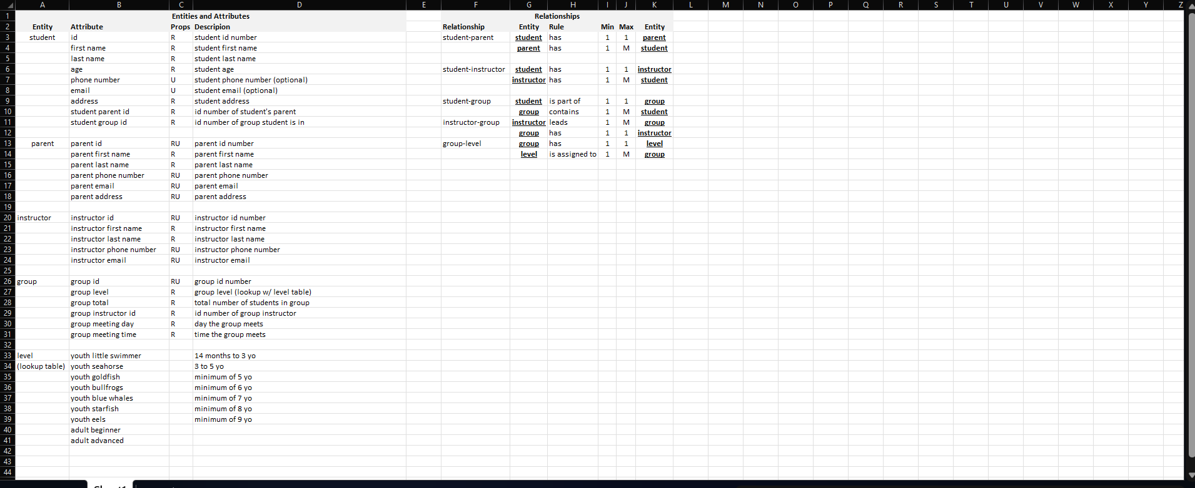
ER-Data Requirements

Slide 8
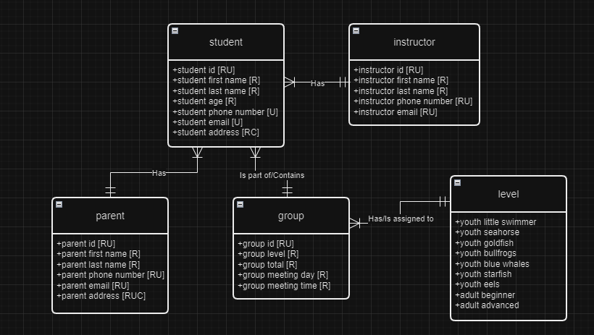
Conceptual Data Model

Slide 9
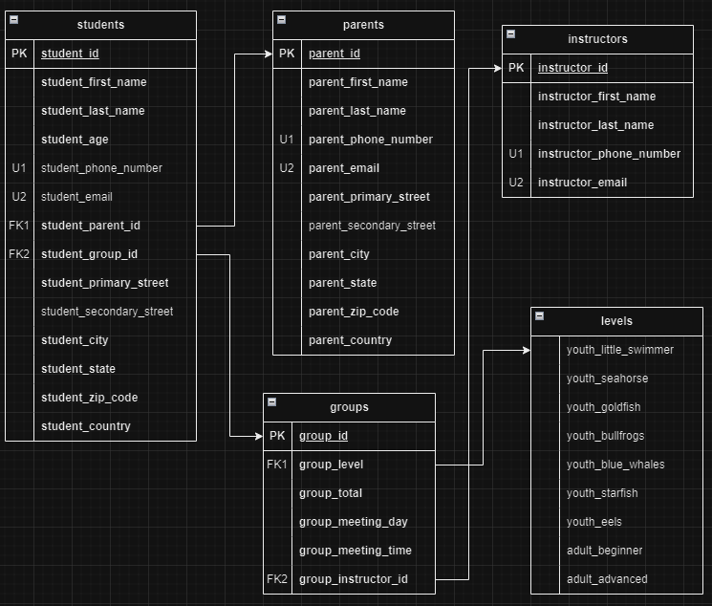
Logical Data Model

Slide 10
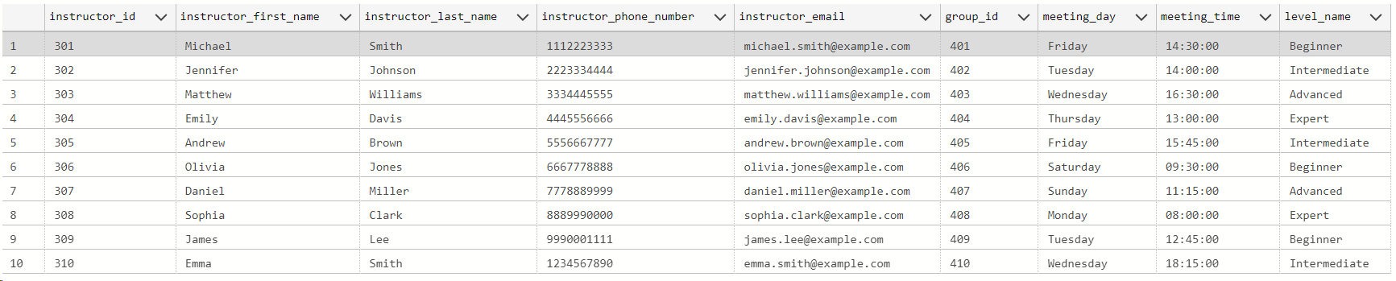
CREATE VIEW instructor_view AS
SELECT
i.instructor_id,
i.first_name AS instructor_first_name,
i.last_name AS instructor_last_name,
i.phone_number AS instructor_phone_number,
i.email AS instructor_email,
g.group_id,
g.meeting_day,
g.meeting_time,
l.level_name
FROM
instructors i
JOIN
groups g ON i.instructor_id = g.instructor_id
JOIN
levels l ON g.level_id = l.level_id;
select * from instructor_view

Slide 11
CREATE VIEW parent_view AS
SELECT
s.student_id,
s.first_name + ' ' + s.last_name as student_name,
s.age as student_age,
s.phone_number as student_phone_number,
s.email as student_email,
s.StreetAddress,
s.StateOrRegion,
s.PostalCode,
s.country,
i.first_name + ' ' + i.last_name as instructor_name,
i.phone_number as instructor_phone_number,
i.email as instructor_email,
g.group_id,
l.level_name,
CONVERT(VARCHAR(10), g.meeting_day) + ' ' + CONVERT(VARCHAR(8), g.meeting_time, 108) as weekly_group_meeting
FROM students s
JOIN parents p ON s.student_parent_id = p.parent_id
JOIN instructors i ON s.instructor_id = i.instructor_id
JOIN groups g ON g.group_id = s.student_group_id
JOIN levels l ON g.level_id = l.level_id; GO
select * from parent_view

Slide 12
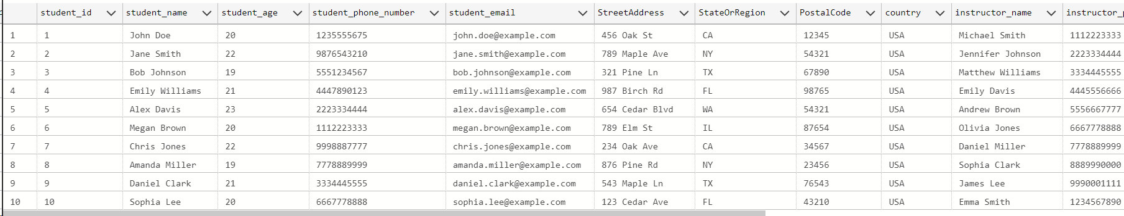
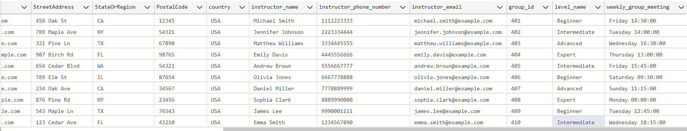

Slide 13
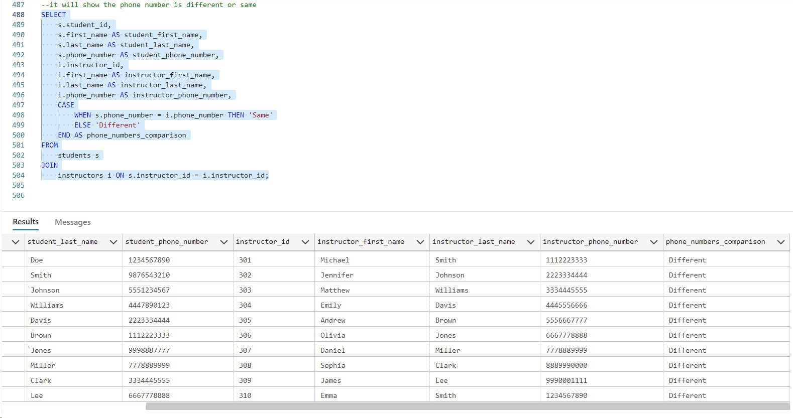

Slide 15
CREATE VIEW student_view AS
SELECT
s.student_id,
s.first_name AS student_first_name,
s.last_name AS student_last_name,
s.age AS student_age,
s.phone_number AS student_phone_number,
s.email AS student_email,
s.StreetAddress AS student_StreetAddress,
s.City AS student_City,
s.StateOrRegion AS student_StateOrRegion,
s.PostalCode AS student_PostalCode,
s.Country AS student_Country,
p.parent_id,
p.first_name AS parent_first_name,
p.last_name AS parent_last_name,
p.phone_number AS parent_phone_number,
p.email AS parent_email,
i.instructor_id,
i.first_name AS instructor_first_name,
i.last_name AS instructor_last_name,
g.group_id,
g.level_id,
g.total_students,
g.meeting_day,
g.meeting_time,
l.level_name
FROM
students s
JOIN
parents p ON s.student_parent_id = p.parent_id
JOIN
instructors i ON s.instructor_id = i.instructor_id
JOIN
groups g ON s.student_group_id = g.group_id
JOIN
levels l ON g.level_id = l.level_id;
SELECT * FROM student_view;

Slide 16
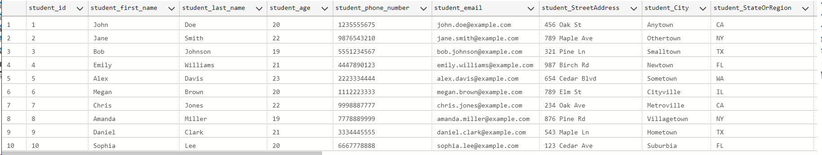
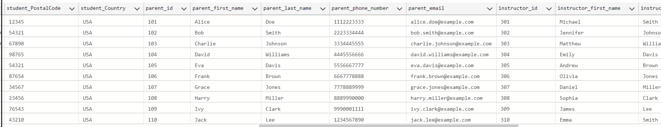
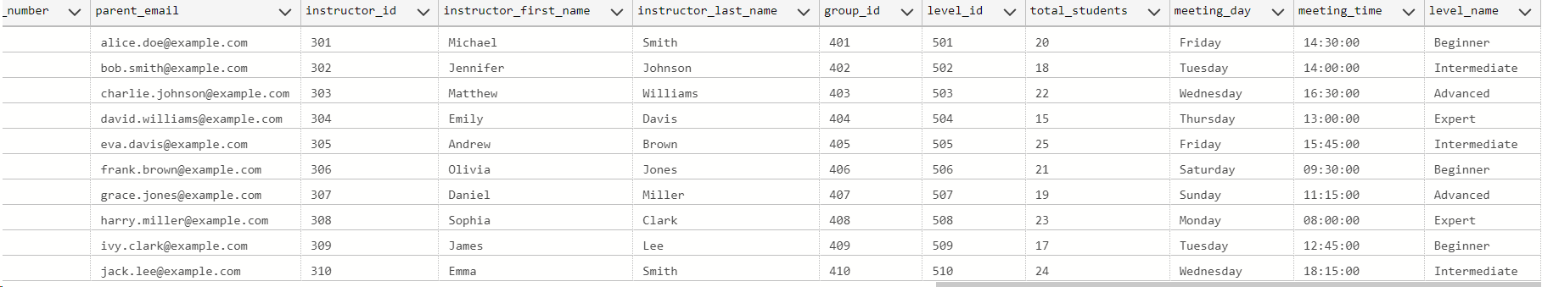

Slide 17
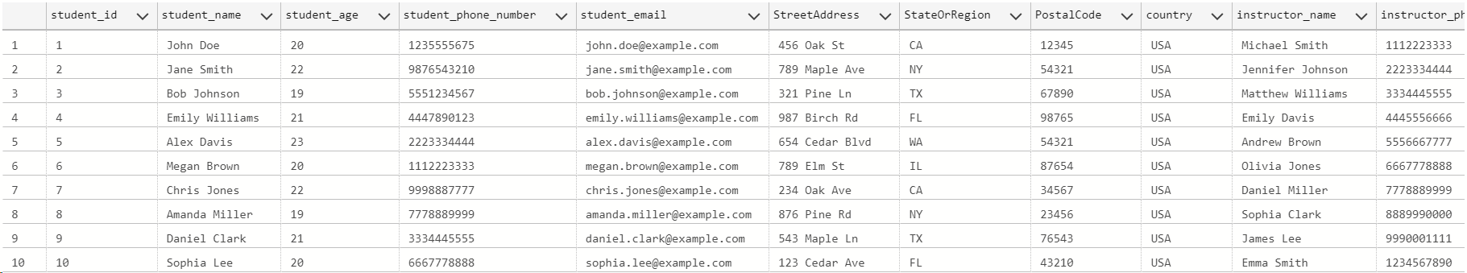
DROP PROCEDURE IF EXISTS p_upsert_parent_details;
GO
CREATE PROCEDURE p_upsert_parent_details (
@student_email VARCHAR(50),
@student_phonenumber CHAR(10),
@student_id VARCHAR(20)
) AS
BEGIN
IF EXISTS (SELECT * FROM parent_view WHERE student_email = @student_email)
BEGIN
UPDATE parent_view
SET student_phone_number = @student_phonenumber
WHERE student_id = @student_id;
END
ELSE
BEGIN
INSERT INTO parent_view (student_id, student_email, student_phone_number)
VALUES (@student_id, @student_email, @student_phonenumber);
END
END;
GO

Slide 18
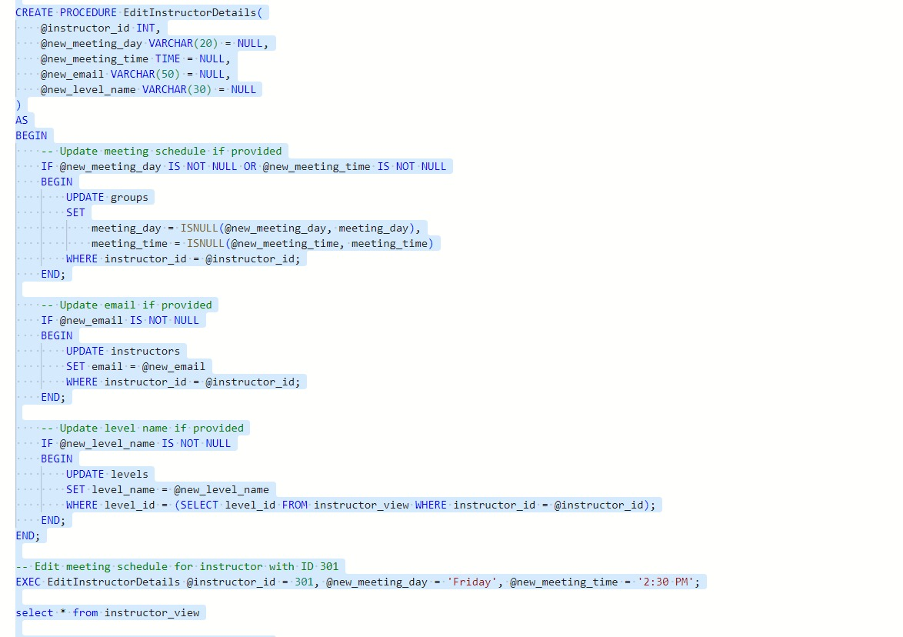

Slide 19
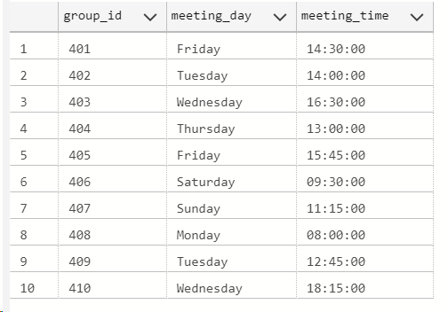
--Group Schedule
SELECT g.group_id, g.meeting_day, g.meeting_time
FROM groups g
WHERE g.group_id = group_id;

Slide 20
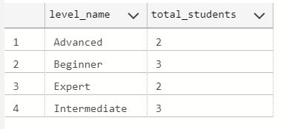
--Total Students per Level
SELECT l.level_name, COUNT(s.student_id) AS total_students
FROM levels l
JOIN groups g ON l.level_id = g.level_id
JOIN students s ON g.group_id = s.student_group_id
GROUP BY l.level_name;

Slide 21
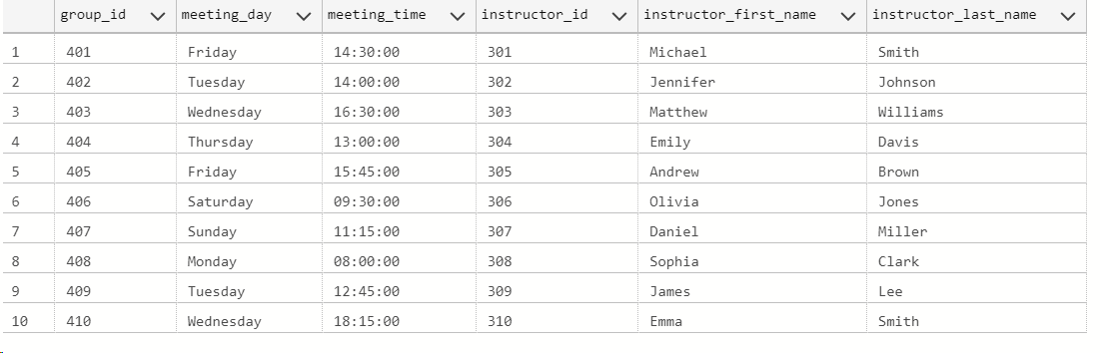
--List of group with instructor Details
SELECT g.group_id, g.meeting_day, g.meeting_time, i.instructor_id, i.first_name AS instructor_first_name, i.last_name AS instructor_last_name
FROM groups g
JOIN instructors i ON g.instructor_id = i.instructor_id;

Slide 22

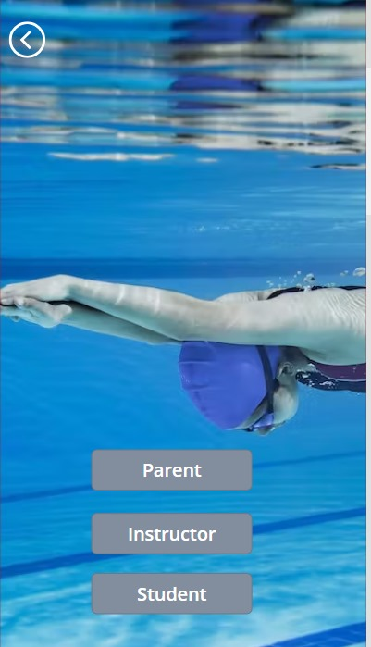
Implementation Screens – Login Interface
Parents can log in using their unique credentials to access personalized information about their child's swim lessons, schedules, and progress.
Instructors will have dedicated login credentials, granting them access to lesson planning tools, participant profiles.
Students, depending on their age and level, may have limited access to view their schedules, achievements, and other relevant information.

Slide 23
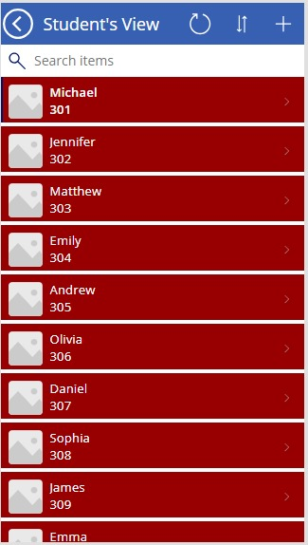
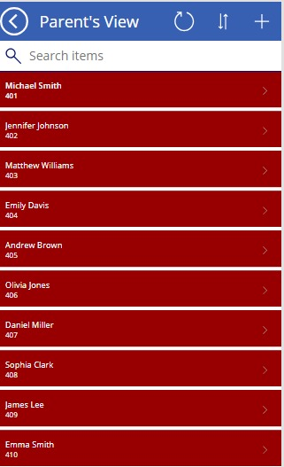
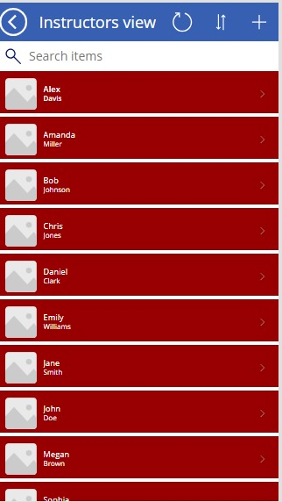
Implementation Screens – Parent, Instructor and Student View

Slide 24
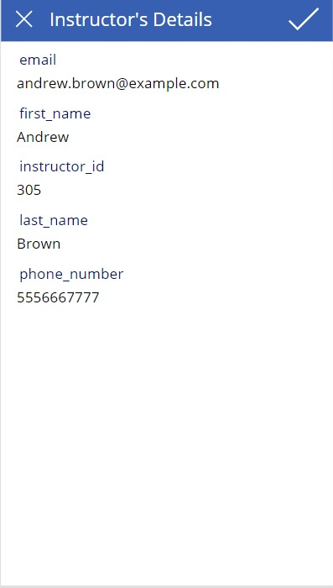
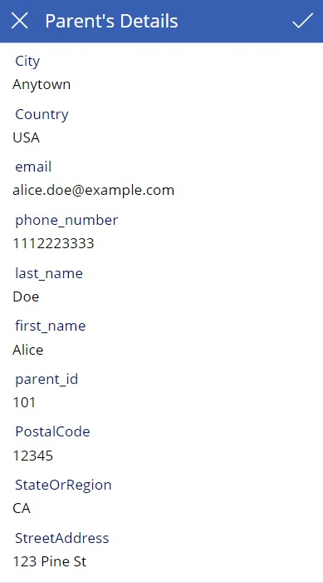
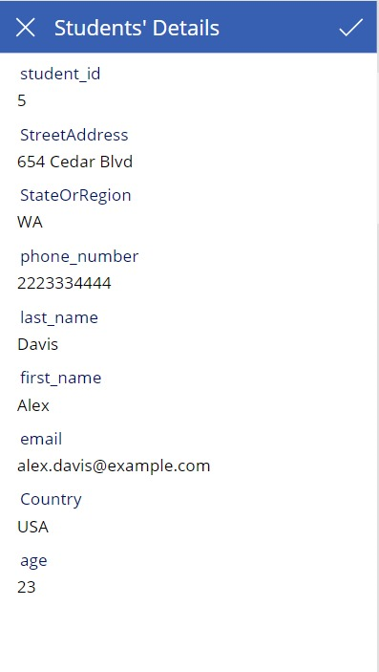
Implementation Screens – Instructor, Parent, Student Details

Slide 25

Conclusion: Limitations and Discussions
In conclusion, the project presents a transformative solution to the challenges faced in managing swim lesson data. By streamlining data collection, enhancing information security, and improving accessibility, the system is poised to revolutionize swim lessons management and elevate the overall experience for both the swim company and its participants.
However, it is crucial to acknowledge certain limitations and challenges that may impact the project:
As the swim company grows or undergoes changes, scalability challenges may emerge. The system should be designed with scalability in mind to accommodate an increasing volume of data and users without compromising performance.
Adhering to the estimated budget and resource allocation is crucial for the success of the project.

